Slide 1
Python: The Basics

Slide 2
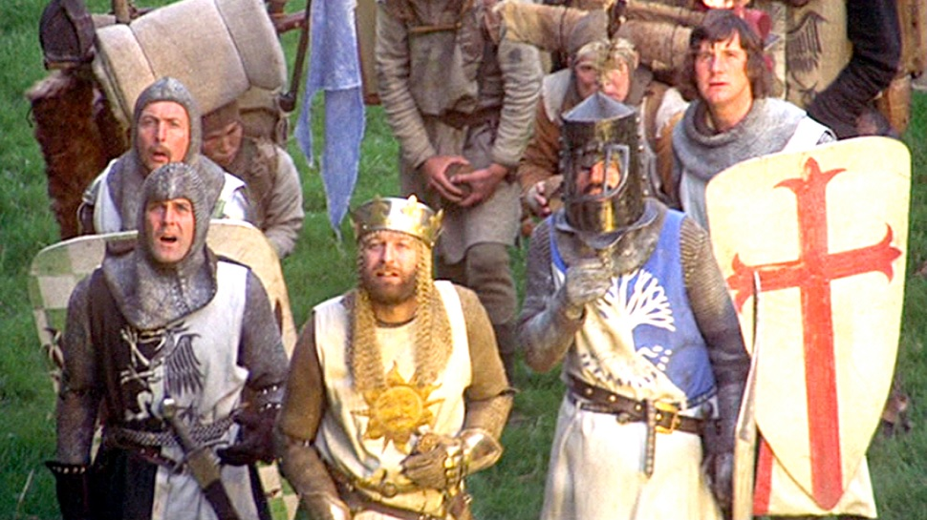
Python Origin
Created by Guido Van Rossum in early 1990s
Conceived at late 1980’s
Named after “Monty Python’s Flying Circus”
Short History of Python Versions
Python 1.0 – January 1994
Python 2.0 – October 2000
Python 2.6 – October 2008
Python 2.7 – July 2010 (latest version)
Python 3.0 – December 2008
NOTE: Mostly compatible with Python 2

Slide 3
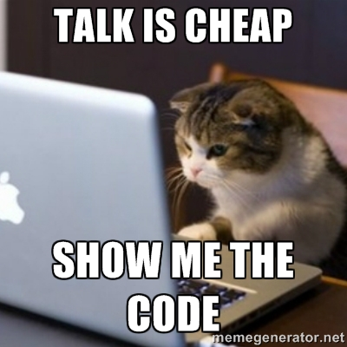
A Code Sample
x = 34 - 23 # A comment.
y = “Hello” # Another one.
z = 3.45
if z == 3.45 or y == “Hello”:
x = x + 1
y = y + “ World” # String concatenation
print x
print y

Slide 4
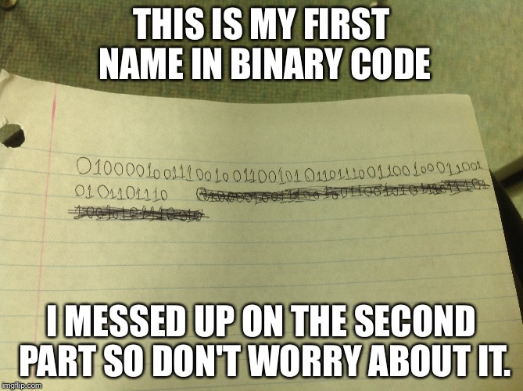
Enough to Understand the Code
Assignment uses = and comparison uses ==.
For numbers + - * / % are as expected.
• Special use of + for string concatenation.
• Special use of % for string formatting (as with printf in C)
Logical operators are words (and, or, not) not symbols
The basic printing command is print.
The first assignment to a variable creates it.
• Variable types don’t need to be declared.
• Python figures out the variable types on its own.

Slide 5
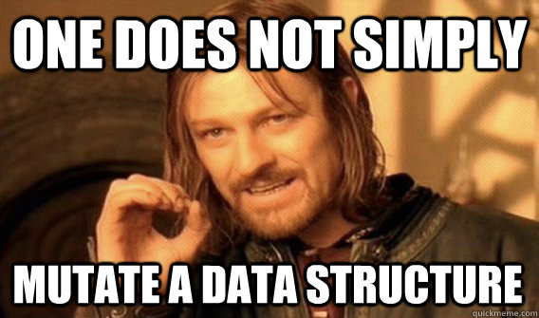
Basic Datatypes
Integers
z = 5 / 2 # Answer is 2, integer division.
Floats
x = 3.456
Strings
Can use “” or ‘’ to specify.
"abc" 'abc' (Same thing.)
• Unmatched can occur within the string.
"matt's"
• Use triple double-quotes for multi-line strings or strings than contain both ' and " inside of them:
"""a'b"c"""

Slide 6
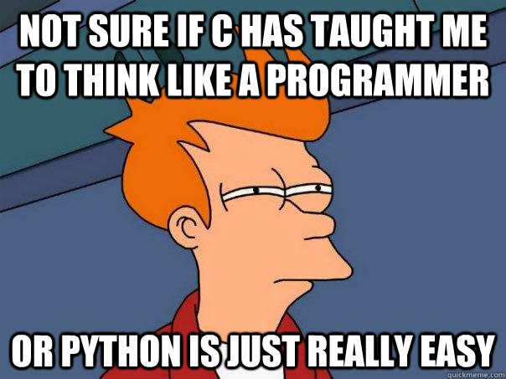
Printing to screen
Python 2: print x
print 6
print 5*4
print tiger #prints the value of the tiger variable
Python 3: print(x)
print 6
print 5*4
print tiger #prints the value of the tiger variable

Slide 7
Whitespace
Whitespace is meaningful in Python: especially indentation and placement of newlines.
Use a newline to end a line of code.
Use \ when must go to next line prematurely.
Use consistent indentation to mark blocks of code .
The first line with less indentation is outside of the block.
The first line with more indentation starts a nested block
Often a colon appears at the start of a new block. (E.g. for function and class definitions.)

Slide 8
Comments
Start comments with # – the rest of line is ignored.

Slide 9
Variables and Assignments
Variable names are case-sensitive, contain letters, numbers or _, cannot start with a number
Variables do not have an intrinsic type
Variables must be assigned before they can be referenced
Variable on the left side, value on right side of = sign
temperature = 98.6
myName = "Monique"
x, y = 0, 100

Slide 10
Reserved Words
You can't use some key words as variables (because they're used by Python for other things)
and, assert, break, class, continue, def, del, elif, else, except, exec, finally, for, from, global, if, import, in, is, lambda, not, or, pass, print, raise, return, try, while

Slide 11
Simple Types
Numbers, strings and tuples are simple types (also called immutable). If you assign a variable with a simple type to another variable, Python makes a copy of the value and puts it into the new variable
Example:
x = 3
y = x
y = y + 1 # sets y to 4, value of x still 3

Slide 12
More Complicated Types
Lists, objects (also called mutable), when you assign one variable to another, both variables end up pointing to the same values in memory
List example:
myList = ["John", "Paul", "George", "Ringo"]
yourList = myList # this makes both variables point to the same value
yourList = ["Yoko","John"] # myList now also points to ["Yoko","John"]

Slide 13
Lists and Tuples (part 1)
Similar to arrays, but every time you assign a Tuple to a variable it makes a new copy. Assigning a List to a variable makes the variable "point" to the list's value. List elements can change. Tuple elements cannot.
Here's how to assign them to variables:
someList = [10,20,30,40]
someTuple = (10,20,30,40)

Slide 14
Lists and Tuples (part 2)
To reference one element in a list or tuple (or one character in a string!), put it in square brackets:
years = ["freshman","sophomore","junior","senior"]
print years[0] # prints "freshman" (without the quotes)
Changing a list element
years[0] = "fish"
print years[0] # prints "fish" (without the quotes)

Slide 15
Lists and Tuples (part 3)
Lists and tuples can contain all different types of elements
Example:
historyClass = ("HIST","Early American Culture",93, 4)

Slide 16
Lists and Tuples (part 4)
Indexing starts at 0 (first element). Negative indexing starts at -1 (last element)
cities = ["College Station","Bryan","Brenham","Iola","North Zulch","Snook"]
cities[0] # "College Station"
cities[4] # "North Zulch"
cities[-2] # "North Zulch"

Slide 17
Lists and Tuples (part 5)
Slicing up lists, tuples and strings.
slogan = "Don't mess with Texas"
slogan[16:21] # "Texas"
slogan[16:-1] # "Texas"
slogan[11:] # "with Texas"
slogan[:5] # "Don't"
slogan[:] # "Don't mess with Texas"

Slide 18
True or False (Boolean)
Operators: ==, !=, <, <=, >, >=, in
Examples:
x, y, name = 1, 4, "Harry"
x == y # False
x < y # True
'r' in name # True

Slide 19
+ Operator
Concatenates lists, tuples and strings together
(1, 2, 3) + (4, 5, 6) # (1, 2, 3, 4, 5, 6)
[1 ,2 ,3] + [4, 5, 6] # [1, 2, 3, 4, 5, 6]
"I like" + " " + "Python" # "I like Python"

Slide 20
* Operator
Repeats multiples of lists, tuples and strings
(1, 2, 3) * 3 # (1, 2, 3, 1, 2, 3, 1, 2, 3)
[4, 5, 6] * 2 # [4, 5, 6, 4, 5, 6]
"Python" * 4 # "PythonPythonPythonPython"

Slide 21
Main Differences between Python 2 and 3
Input
Python 2: raw_input("Enter a number:")
Python 3: input("Enter a number:")
Print
Python 2: Print x Python 3: Print(x)
Integer division
Python 2: 3/2 #1 (int/int -> int)
Python 3: 3/2 #1.5 (int/int -> real)
Loop variables global (Python2) changed to local (Python3)

Slide 22
List method: append
friends = ["Al","Bev"]
friends.append("Chuck") #friends=["Al","Bev","Chuck"]
friends.append(1,"Chuck") #friends=["Al","Chuck","Bev"]
append is a method of lists

Slide 23
List method: extend
friends = ["Al","Bev"]
moreFriends = ["Chuck","Dee"]
friends.append(moreFriends) #friends=["Al","Bev",["Chuck","Dee"]]
friends.extend(moreFriends) #friends=["Al","Bev","Chuck","Dee"]
extend is another method of lists
+ creates a new list, extend modifies current list

Slide 24
List methods: index, count, remove, reverse, sort
friends = ["Al","Bev","Chuck","Dee","Bev"]
friends.index("Dee") # 3
friends.count("Bev") # 2
friends.remove("Bev") # removes first instance only: ["Al","Chuck","Dee","Bev"]
friends.reverse() # ["Bev","Dee","Chuck","Al"]
friends.sort() # removes first instance only: ["Al","Bev","Chuck","Dee"]

Slide 25
Convert tuple to list and back
x = [1,2,3]
y = tuple(x) # y = (1,2,3)
z = list( (5,6,7,8,9) ) # z = [5,6,7,8,9]

Slide 26
Dictionaries
Dictionaries are like "Super Lists", where instead of referring to a ordered integer index (0,1,2,3... etc) , the key can be any simple type
Examples:
class= {'subject':'Math','days':'MTWHF','nStudents':100}
class[nStudents] # 100
class['subject'] = "Mathematics" #changes 'Math' to 'Mathematics'
class.keys() # ['subject','days','nStudents']
class.values() # ['Mathematics','MTWHF',100]

Slide 27
Functions
Functions are like sub-processes that are executed by using just their name and the values they should use
def add1(num):
return num + 1
def makeClass(subj, whenTaught, howMany):
class = {'subject':subj, 'days':whenTaught, 'nStudents':howMany}
return class

Slide 28
Function arguments
The order of the values is important:
def y(slope,x,yIntercept):
return slope * x + yIntercept
yValue = y(4,2,10) # slope is 4, x is 2, yIntercept is 10
# yValue gets set to 18

Slide 29
Optional Arguments to Functions
Easier shown than described
def add(a,b=0, c=0, d=0, e=0):
return a + b + c + d + e
add(10) # 10
add(1,2,3) # 6

Slide 30
Functions (continued): tricky bits
All functions return some value
If no return statement, the value returned is None
All functions must have different names

Slide 31
Program control, or connecting it all
Statements, loops, blocks
Example:
if x == 3:
print "X equals 3."
elif x == 2:
print "X equals 2."
else:
print "X equals something else."
print "This is outside the 'if'."

Slide 32
While loop
Keep doing something as long as a condition is met
Example:
x = 1
while x < 5:
print(x)
x += 1 # very important! Must eventually make the condition False!
print("All Done")

Slide 33
For loop
Execute the interior of the loop a certain number of times
for x in range(5):
print(x)
print("Done")

Slide 34
If...elif...else...
Example:
x = input("Enter a fruit:")
if (x == "Orange"):
print ("My color is orange")
elif (x == "Banana"):
print ("I like yellow")
else:
print ("It's not orange or yellow")

Slide 35
...and Lots More!
Python is a powerful language for many, many applications today! It includes elements of object-oriented programming (OOP), libraries, data hiding.
Most of these features are left for you to explore!

